Slide 1

Code Generation Using LLMs and Evaluation
Exploring advanced LLM techniques for secure code generation.
Team 5 - Mukesh Rajmohan, Praneeth Ravirala, Utkarsh Desai.
Course: AIT 726 - NLP with Deep Learning.
Professor: Lindi Liao.
University: George Mason University.

Slide 2

Project Overview
1
Goal
2
Challenges
Develop LLM for SQL code generation from natural language.
Ensure code security, modularity, and maintainability.
3
Significance
Improve long-term usability of automated code generation.
Secure, reusable and maintainable code.

Slide 3

Related Work
1
Content-Enhanced BERT
Incorporates table-specific knowledge for Text-to-SQL tasks but lacks focus on security.
2
CodexDB
Adapts GPT-3 for SQL generation, emphasizing customization over security.
3
GitHub Copilot
Assists with basic code generation but suffers from non-reproducible and insecure outputs.

Slide 4

Datasets
Dataset
Focus
Components
SQL-Create-Context
NL to SQL
Question, Context, Answer

Slide 5
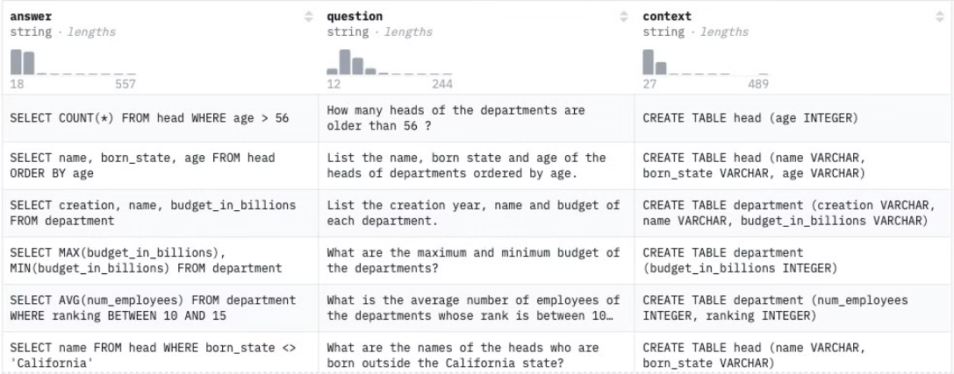
Datasets Sample

Slide 6
Framework
Specialized LLM for SQL - Using T5 or BERT Transformer
Modular Design
Security
Maintainability
Targeted Specialization
Generate reusable components for better maintenance.
Prevent common vulnerabilities like SQL injection.
Produce readable, well-commented code.
Code generation model with focus on SQL.

Slide 7
Software and Hardware
Software
Hardware
The code generation model is implemented in Python.
Training LLMs requires specialized hardware.
Python's extensive libraries, like Hugging Face and PyTorch, are key for building and training the LLM.
The project uses a GPU for accelerating the model's training.
Pandas for data manipulation
Google Colab T4 GPU is utilized for its computational power and cost-effectiveness.
Transformers for natural language processing
Sklearn for machine learning tasks
PyLint for code linting and Bandit for security analysis

Slide 8





Algorithms/Approaches
Baseline: T5 Transformer
Text-to-text approach with bidirectional encoding.
Steps:
Preprocessing and splitting dataset.
Encoding "question" and "context" as input pairs.
Fine-tuning model with training data and validating predictions.
Enhanced: Hierarchical Decomposition
Three-stage process for complex SQL generation.
Stages:
Stage 1: Identify high-level SQL components.
Stage 2: Fill details for each component.
Stage 3: Construct complete SQL query.

Slide 9
Baseline Model - T5 Model
The baseline model is a T5 Transformer for code generation.
The T5 model is a Text-to-Text Transformer with bidirectional encoding.
It can be used for tasks like translation, generation, and code synthesis.
The T5 model's bidirectional encoding allows it to understand the context of input text.
Its unidirectional decoder decodes output from left to right, enabling sequence generation.

Slide 10






Baseline Model Implementation
Dataset Loading and Preprocessing
A subset of 10,000 samples was imported from the SQL-Create-Context dataset using Pandas. This was done due to computational resource limitations.
Data Splitting
The dataset was divided into 8,000 training samples and 2,000 testing samples using Sklearn's train_test_split function.
Feature Encoding
The "question" and "context" were combined as input features. The "answer" field was designated as the output label.
Data Preparation for Training
The data was converted into a tensor format suitable for PyTorch, with a batch size of 2. This batch size was chosen to optimize training performance and memory utilization.
Training the T5 Model
The T5 model was trained using the Adam optimizer to minimize the loss function. Step-by-step explanations were added as comments within the training code to improve clarity and maintainability.
Model Testing
The model's performance was evaluated using a subset of the test data to manage memory constraints. Predicted SQL queries were decoded using the T5 tokenizer to generate the final SQL output.

Slide 11
Baseline Model Limitations
High Memory Usage: The model requires significant memory resources during prediction, limiting the dataset size for testing.
Computational Resource Constraints: The training process was limited by available computing power, resulting in a smaller training dataset.
Limited Generalization in Testing: The evaluation was conducted on a small portion of the test data, reducing the model's generalizability and reliability.

Slide 12



Enhanced Model - T5 with Hierarchical Decomposition
Stage 1 - Component Identification
1
Identifies high-level SQL components
Stage 2 - SQL Detail Filling
2
Predicts details for each component
Stage 3 - Query Construction
3
Combines details into a valid query
Hierarchical decomposition is a modular approach for complex NLP tasks, such as translating natural language questions into SQL queries. This approach breaks down the task into multiple stages, each focused on a specific aspect, improving robustness, interpretability, and maintainability.

Slide 13
Motivation for Hierarchical Decomposition
Complexity of SQL Query Generation
Modularity and Scalability
Generating an entire SQL query from a natural language question is challenging due to the diversity of language patterns, schema complexities, and query structures. Complex queries involving multiple clauses increase the likelihood of errors if handled in a single step.
By breaking the task into smaller, focused stages, the model can learn each component more effectively, improving the overall accuracy. Errors in one stage can be localized and fixed without affecting the entire pipeline.
Improved Robustness
Interpretability
Each stage is trained and validated separately, ensuring high accuracy for specific subtasks before moving to the next stage. The pipeline can adapt to schema changes or new types of queries more easily by retraining specific stages.
Decomposing the process allows for better debugging and understanding of where errors occur. Each stage produces intermediate outputs, which can be inspected for correctness.

Slide 14
Evaluation of Models: Fuzz Ratio
The Fuzz Ratio, a string similarity metric, helps assess the performance of SQL query generation models by comparing generated components (or full queries) to expected counterparts. This approach offers both advantages and limitations.
Advantages of the Fuzz Ratio
Limitations of the Fuzz Ratio
Handles partial matches, offering graded evaluation.
While effective, relying solely on string similarity may overlook semantic nuances.
Accounts for order and character similarity, measuring similarity even in noisy outputs.
Complex query structures or subtle errors in meaning might not be fully captured by this simple metric.
Provides granular feedback (percentage score) for nuanced analysis and identification of areas needing improvement.
More advanced evaluation methods could potentially provide a more comprehensive assessment of model performance.

Slide 15

Results and analysis
Baseline model
Implementation
1
Used the T5 model fine-tuned on a subset of the SQL-Create-Context dataset due to computational constraints (10,000 samples for training).
2
Memory Constraints
High memory usage during testing forced evaluation on only 50 test samples instead of the full dataset of 2,000 samples.
Performance
3
Accuracy: Successfully generated syntactically correct queries for simple cases.
Limitations: Struggled with complex queries involving multiple clauses. Errors due to lack of modularity in query generation.

Slide 16
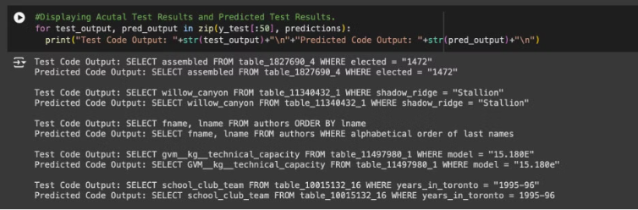
Model Evaluation
The T5 model effectively handles text-to-text sequences. It successfully generated SQL queries for simple cases. However, it struggled with complex queries.
The model's memory usage limited the testing data to only 50 samples, preventing a comprehensive evaluation.

Slide 17



Results and analysis
Enhanced model - Hierarchical decomposition
Performance Improvements
Robustness
Scalability
Accuracy increased for complex queries due to modular and staged processing.
Errors in one stage localized without propagating to the entire query.
More effective handling of complex SQL queries and diverse schemas.

Slide 18
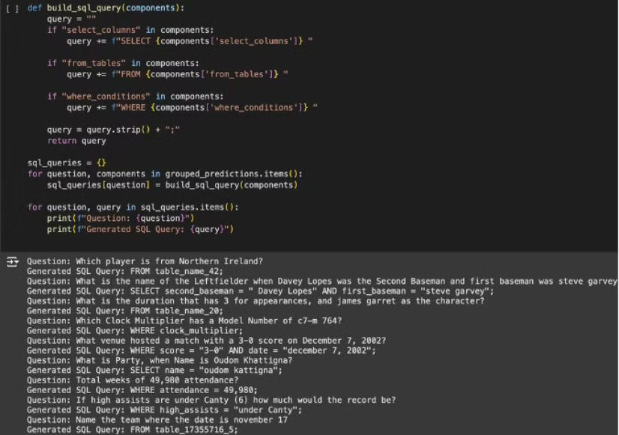
Model Results
Strengths:
Modular approach ensures high accuracy for individual components (e.g., SELECT, WHERE).
Handles numeric and text-based conditions with good accuracy.
Reduces syntax errors by systematically assembling SQL queries.
Weaknesses:
Some generated queries lack semantic details (e.g., full WHERE clauses).
Improvements are needed in complex schema relationships and multi-table queries.

Slide 19
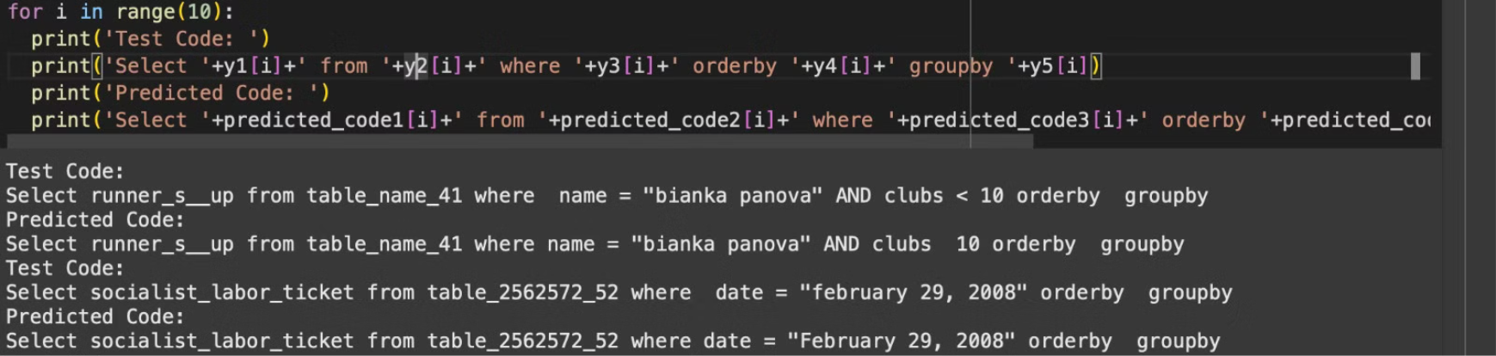
Model Results
Performance Highlights
Addition of New Components
The enhanced model now achieves higher accuracy as the test queries match the generated queries across various examples.
The enhanced model will also include ORDER BY clause generation, correctly identifying the sorting field.
The enhanced model resolves weaknesses in the baseline model such as: accurate representation of complex clauses, including WHERE, ORDER BY, and GROUP BY.
It will also ensures proper grouping of data, particularly in aggregate queries (e.g., COUNT, SUM).
Future work includes adding the HAVING clause for filtering grouped results based on conditions.

Slide 20
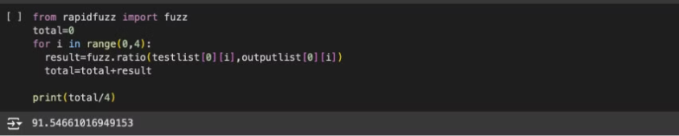
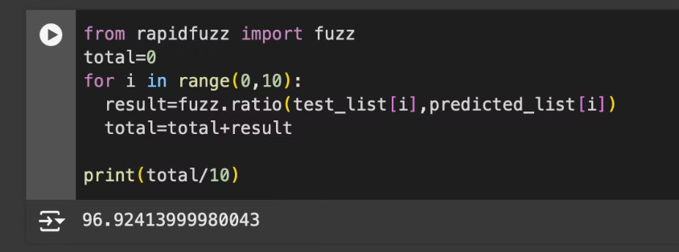
Results and analysis
Performance Measure
90-100%: High similarity, likely correct query.
70-89%: Moderate similarity, possible minor errors.
Below 70%: Low similarity, significant discrepancies.
Baseline Model
Enhanced Model
Achieved high accuracy on simple queries, but struggled with complex multi-clause statements.
Maintained high accuracy across both simple and complex queries by leveraging modular predictions.

Slide 21

Conclusions
Baseline Model
Enhanced Model
T5 showed promise but was limited by memory usage and accuracy on complex queries. Non-modular approach led to difficulties in maintaining and debugging generated SQL queries.
Hierarchical decomposition significantly improved modularity and accuracy. Errors localized to specific stages, enhancing debugging and overall robustness.
Impact
Modular and secure SQL generation addresses critical gaps in existing models. Improved maintainability makes the approach viable for real-world applications.

Slide 22


Future Work
Short-Term Goals
Long-Term Goals
Implement specialized models for SQL components.
Address sampling issues to improve consistency across components.
Integrate a parser to validate generated queries.
Extend evaluation beyond Fuzz Ratio.
Explore more powerful models like Codex or BERT.
Adapt the model to handle larger datasets and complex schemas.

Slide 23
References
1
T5
2
Dutta, N.
(n.d.). unknown link
(2024, October 7). Fuzzy String Matching – a hands-on guide. Analytics Vidhya. https://www.analyticsvidhya.com/blog/2021/07/fuzzy-string-matching-a-hands-on-guide/
3
Isaacndirangumuturi
4
b-mc2/sql-create-context · Datasets at Hugging Face
(2023, October 5). Code Generation with T5 Transformer. Kaggle. https://www.kaggle.com/code/isaacndirangumuturi/code-generation-with-t5-transformer
(2001, May 12). https://huggingface.co/datasets/b-mc2/sql-create-context?row=0
5
Seq2SQL: Generating Structured Queries from Natural Language using Reinforcement Learning | Semantic Scholar
6
BERT
(n.d.). https://huggingface.co/docs/transformers/en/model_doc/bert
(2017, August 31). https://www.semanticscholar.org/reader/cbd569036fc72ae7ff747350b91816440282596b
7
Content-Enhanced BERT-based Text-to-SQL Generation
8
CodexDB: Generating Code for SQL Processing Using GPT-3 Codex
Tong Guo, Huilin Gao. https://arxiv.org/pdf/1910.07179v5
Immanuel Trummer. https://arxiv.org/pdf/2204.08941
9
A Review on Code Generation with LLMs: Application and Evaluation
10
GitHub Copilot AI Pair Programmer: Asset or Liability?
Jianxun Wang, Yixiang Chen. https://ieeexplore.ieee.org/stamp/stamp.jsp?tp=&arnumber=10403378
Arghavan Moradi Dakhel, Vahid Majdinasab, Amin Nikanjam, Foutse Khomh, Michel C. Desmarais. https://arxiv.org/pdf/2206.15331
11
b-mc2/sql-create-context · Datasets at Hugging Face
12
Vezora/Tested-143k-Python-Alpaca · Datasets at hugging face
(2001, May). unknown link
(2001, September). https://huggingface.co/datasets/Vezora/Tested-143k-Python-Al

Slide 24

We are happy to answer any questions you may have.

Slide 25

THANK YOU!

